Slide 2
Activate local internal service
Modify module note

Slide 3
Activate local internal service
Why? Server be reboot and some service not set be activated after reboot
check on every Monday morning

Slide 4
Procedure
New screen
Start service
Flat : http://192.168.3.152:7555/flat/
Noma : http://192.168.1.123:8023/map/
Jupyter notebook: http://192.168.1.123:8000/tree
module_note: http://192.168.3.152:8021/
flat: /home/covmo/miniconda3_new/envs/py310/bin/python /home/covmo/app/Flaton/manage.py runserver 0.0.0.0:7555
Noma: /home/covmo/miniconda3/envs/py37/bin/python /home/covmo/app/Noma/manage.py runserver 0.0.0.0:8023
Jupyter: /home/covmo/miniconda3/envs/py37/bin/python jupyter notebook –port 8000
Module_note:
cd /home/covmo/app/module_note
nohup npm run dev > /dev/null 2>&1 & OR sh /home/covmo/app/script/run_module_note.sh

Slide 5
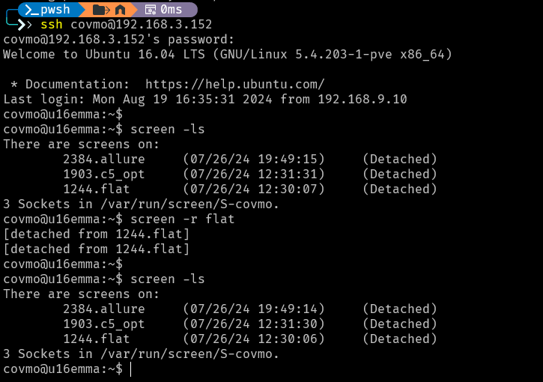
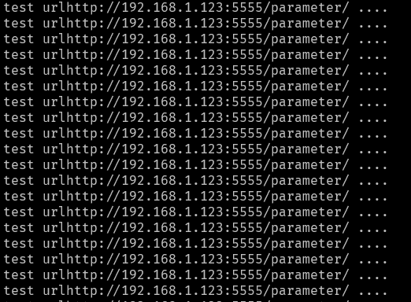
Screen
Hkjh
在screen外面
screen -S {name} :建立新的screen
screen -ls
screen -r {screenShell Id_or_Name} : re-attach
在screen裡面
screen -ls
screen -D : Detach, screen 還是會在背景執行
Ctrl + a + d

Slide 6
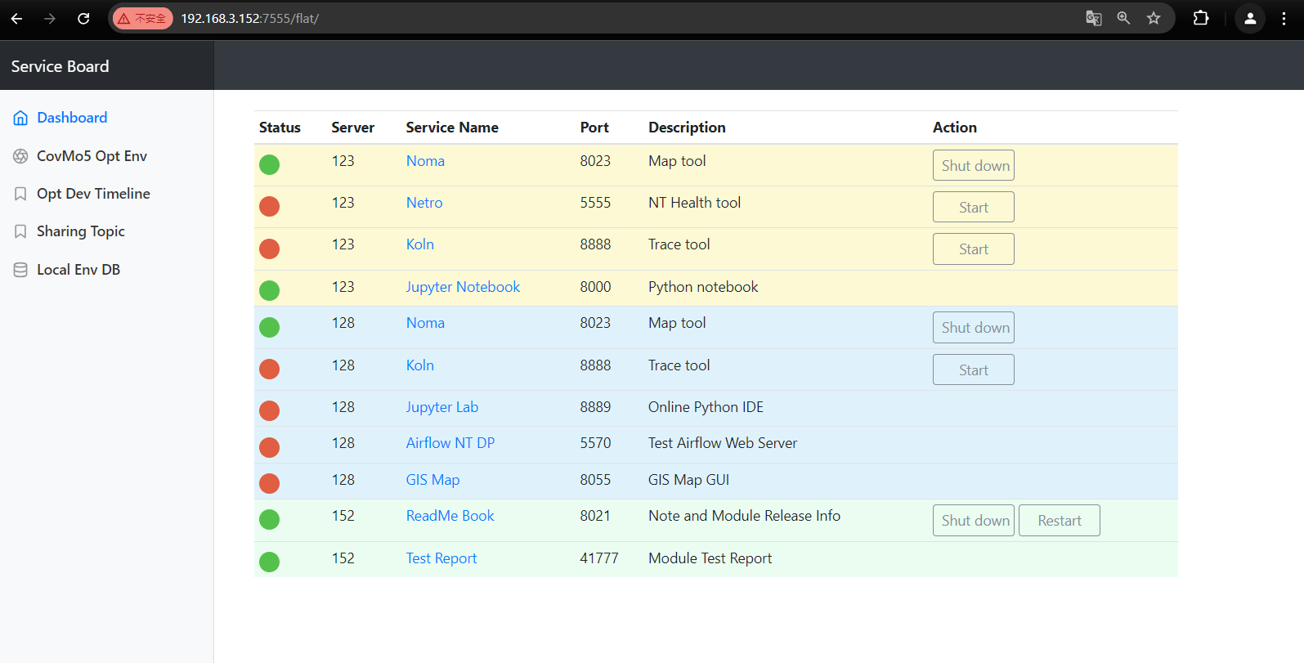
flat

Slide 7
Modify module note

